Slide 1


Getting Started
Java Application Development

Slide 2


HELLO!
I am Sharath K S
You can find me at sharathks84@gmail.com

Slide 3
Today’s Session is about
Application Fundamentals
IDE based Development
Hands-on Development

Slide 4
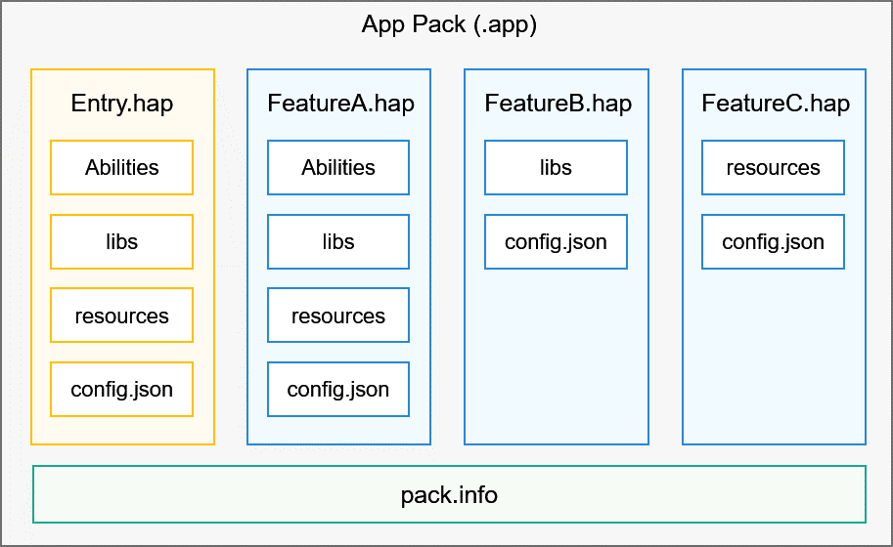
Application Fundamentals
Each .app Pack should have a entry hap module
Feature Hap’s need not have abilities
All information of the Haps are present in pack.info

Slide 5

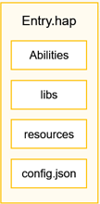

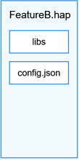
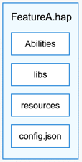
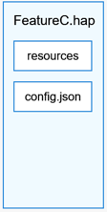
HarmonyOS App Release Pipeline
Deployment and Distribution in AppGallery
Example.app
Entry.hap
FeatureA.hap
FeatureB.hap
FeatureC.hap
Example.app
App Building using DevEco /CommandLine

Slide 6
Framework Layer
UI Framework
Ability Framework
Application Framework
Language compatibility
Framework Layer
This layer provides what you need to develop HarmonyOS applications: application framework and ability framework, specific to multiple languages (like Java, C, C++, and JS), Java and JS UI frameworks, as well as multi-language APIs for hardware and software services.
Application Layer
This layer consists of system applications and third-party applications. Each HarmonyOS application is powered by one or more Feature Abilities (FAs) or Particle Abilities (PAs).

Slide 7
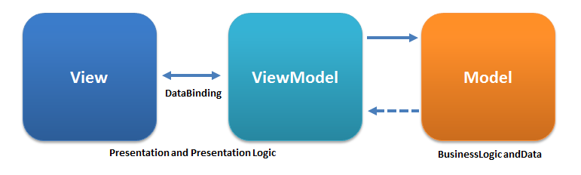
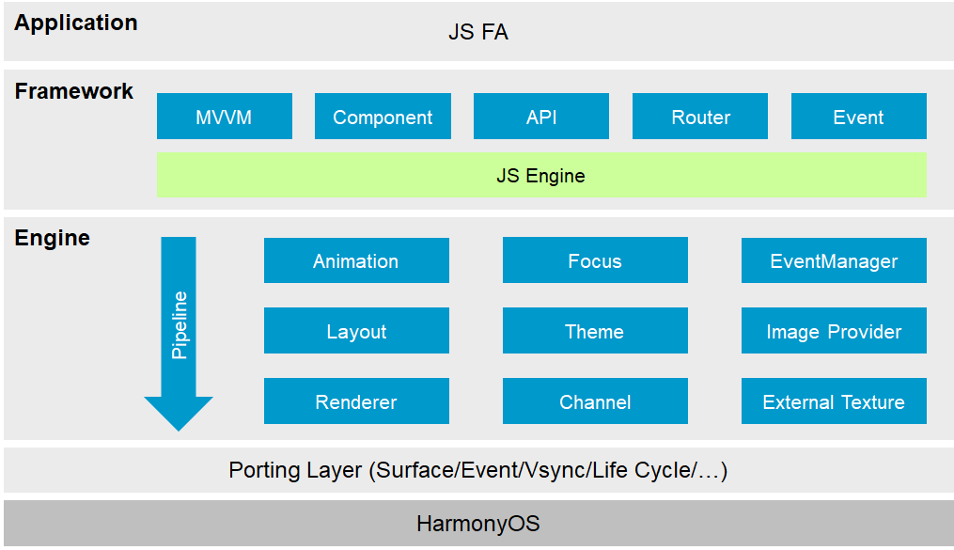

Slide 8
HELLO!
I am Sharath K S
You can find me at sharathks84@gmail.com

